Slide 1
Process Models
1
Software Process
Generic framework activities
Process models and process patterns
Prescriptive process models
Unified Model
Personal & Team Process Model

Slide 2
Social Learning Process
Software is embodied knowledge that is initially dispersed, tacit and incomplete.
To convert knowledge into software, dialogues are needed between users and designers, between designers and tools to bring knowledge into software.
Software development is essentially an iterative social learning process, and the outcome is “software capital”.

Slide 3
What / who / why is Process Models?
What: a road map that helps you create timely, high-quality results.
Who: Software engineers, managers, clients
Why: Provides stability, control, and organization to an activity. Modern SE approaches must be agile and demand ONLY those activities, controls, and work products that are appropriate.
What Work products: Programs, documents, and data
What are the steps: The process you adopt depends on the software that you are building.
How to ensure right: Process assessment mechanisms. The quality, timeliness, and long-term viability.

Slide 4
Software Process
A framework for the activities, actions, and tasks that are required to build high-quality software.
The approach that is taken as software is engineered.
Is not equal to software engineering, which also encompasses technologies that populate the process– technical methods and automated tools.

Slide 5

A Generic Process Model
Framework activities:
  communication, planning, modeling, construction, and deployment.
Umbrella activities:
project tracking and control, risk management, quality assurance, configuration management, technical reviews, and others are applied throughout the process.

Slide 6

Process Flow
Types of Process Flow
Linear process flow executes each of the five activities in sequence.
An iterative process flow repeats one or more of the activities before proceeding to the next.
An evolutionary process flow executes the activities in a circular manner. Each circuit leads to a more complete version of the software.
A parallel process flow executes one or more activities in parallel with other activities ( modeling for one aspect of the software in parallel with construction of another aspect of the software.

Slide 7
Identifying a Task Set
A task set defines the actual work to be done to accomplish the objectives of a software engineering action.
  A list of the task to be accomplished
  A list of the work products to be produced
  A list of the quality assurance filters to be applied

Slide 8
Example of a Task Set for Elicitation
Simple project :
  Make a list of stakeholders for the project.
  Invite all stakeholders to an informal meeting.
  Ask each stakeholder to make a list of features and functions required.
  Discuss requirements and build a final list.
  Prioritize requirements.
  Note areas of uncertainty.
Big project :
  Make a list of stakeholders for the project.
  Interview each stakeholder separately to determine overall wants and needs.
  Build a preliminary list of functions and features based on stakeholder input.
  Schedule a series of facilitated application specification meetings.
  Conduct meetings.
  Produce informal user scenarios as part of each meeting.
  Refine user scenarios based on stakeholder feedback.
  Build a revised list of stakeholder requirements.
  Use quality function deployment techniques to prioritize requirements.
  Package requirements so that they can be delivered incrementally.
  Note constraints and restrictions that will be placed on the system.
  Discuss methods for validating the system.
  Both do the same work with different depth and formality. Choose the task sets that achieve the goal and still maintain quality and agility.

Slide 9
Process Patterns
A process pattern
  describes a process-related problem that is encountered during software engineering work,
  identifies the environment in which the problem has been encountered,
  suggests one or more proven solutions to the problem.
  Problems and solutions associated with a complete process model (e.g. prototyping).
  Problems and solutions associated with a framework activity (e.g. planning) or
  an action with a framework activity (e.g. project estimating).

Slide 10
Process Pattern Types
Stage patterns—define a problem associated with a framework activity for the process. It includes multiple task patterns as well.
Task patterns—defines a problem associated with a software engineering action or work task and relevant to successful software engineering practice
Phase patterns—define the sequence of framework activities that occur with the process, even when the overall flow of activities is iterative in nature. Example includes Sprial Model or Prototyping.

Slide 11
Prescriptive Models
Advocate an orderly approach to software engineering.
Define a prescribed set of process elements and a predictable process work flow.
  Waterfall Model
  V-Model
  Incremental Model
  Evolutionary Model
    Prototyping
    Spiral
    Concurrent

Slide 12
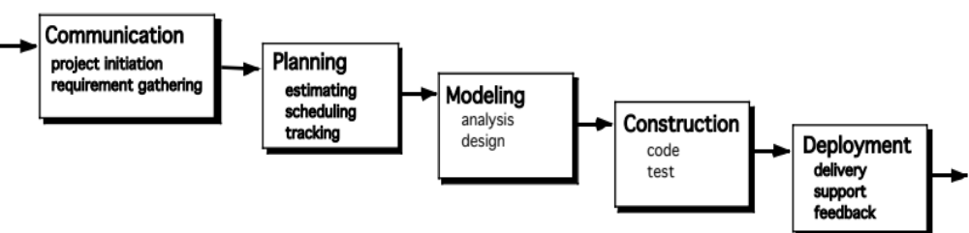
The Waterfall Model
It is the oldest paradigm for SE.
The classic life cycle suggests a systematic, sequential approach to software development.
When requirements are well defined and reasonably stable, it leads to a linear fashion.
Disadvantages:
1. rarely linear, iteration needed.
2. hard to state all requirements explicitly. Blocking state.
3. code will not be released until very late.

Slide 13

The V-Model
Variation of waterfall model
depicts the relationship of quality assurance actions to the actions associated with communication, modeling and early code construction activates.
Team first moves down the left side of the V to refine the problem requirements.
Once code is generated, the team moves up the right side of the V, performing a series of tests that validate each of the models created as the team moved down the left side.

Slide 14
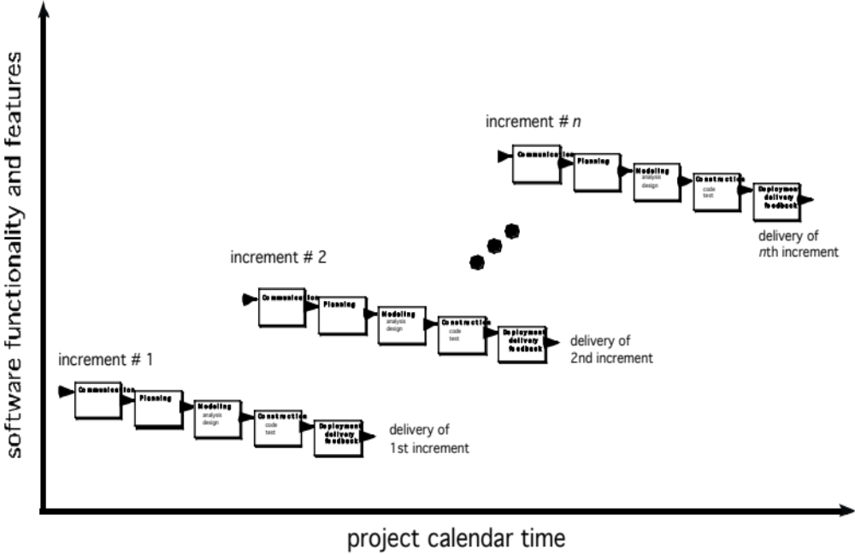
The Incremental Model

Slide 15
The Incremental Model
When initial requirements are reasonably well defined, but the overall scope of the development effort precludes a purely linear process.
Need to expand a limited set of new functions to a later system release.
It combines elements of linear and parallel process flows.
Each linear sequence produces deliverable increments of the software.
The first increment is often a core product with many supplementary features.
Users use it and evaluate it with more modifications to better meet the needs.

Slide 16
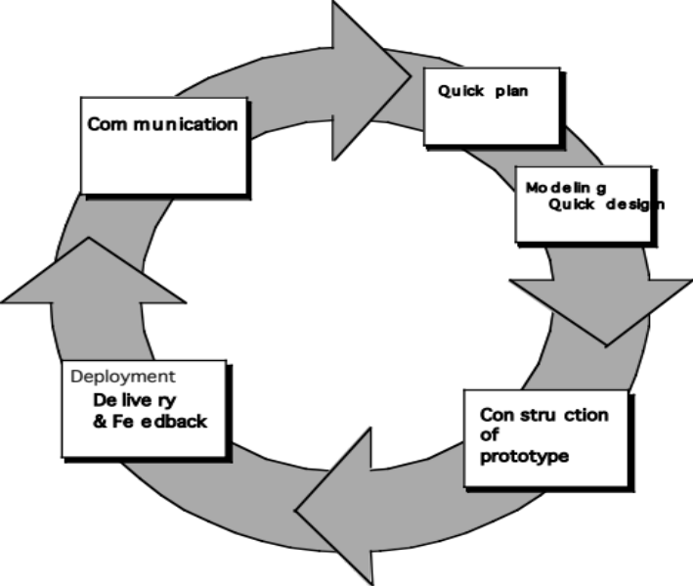
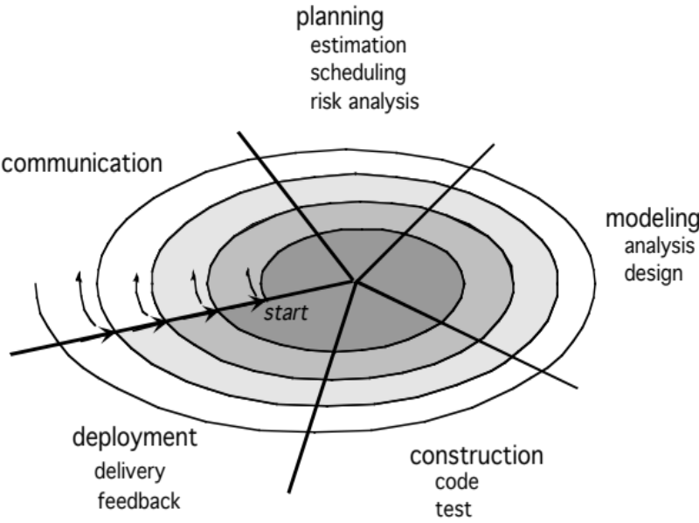
Evolutionary Models
Software system evolves over time as requirements often change as development proceeds.
A limited version is delivered to meet competitive pressure.
Usually a set of core product or system requirements is well understood, but the details and extension have yet to be defined.
It is iterative that enables you to develop increasingly more complete version of the software.
Two types are introduced, namely Prototyping and Spiral models.
Quick
plan
communication
Modeling
Quick design
Deployment
delivery &
feedback
Construction
of prototype

Slide 17
Evolutionary Models: Prototyping
When to use:
  The customer defines a set of general objectives but does not identify detailed requirements for functions and features.
  Developers may be unsure of the efficiency of an algorithm, and the form that human-computer interaction should take.
What step:
  Begins with communication by meeting with stakeholders to define the objective, identify whatever requirements are known, and outline areas where a further definition is mandatory.
  A quick plan for prototyping and modeling (quick design) occur.
  The quick design focuses on a representation of those aspects of the software that will be visible to end users. ( interface and output).
  Design leads to the construction of a prototype that will be deployed and evaluated. Stakeholders’ comments will be used to refine requirements.
Users get a feel for the actual system
Engineers may make compromises in order to get a prototype working quickly.

Slide 18
Evolutionary Models: The Spiral
It couples the iterative nature of prototyping and systematic aspects of the waterfall model
Two main distinguishing features:
  one is cyclic approach for incrementally growing a system and implementation while decreasing its degree of risk.
  The other, a set of anchor point milestones for ensuring stakeholder commitment to feasible and mutually satisfactory system solutions.
A series of evolutionary releases are delivered.
  The first circuit in the clockwise direction might result in the product specification;
  subsequent passes around the spiral might be used to develop a prototype
  Progressively more sophisticated versions of the software.
  Each pass results in adjustments to the project plan. Cost and schedule are adjusted based on feedback. Also, the number of iterations will be adjusted by project manager.
Good to develop large-scale system as software evolves as the process progresses and risk should be understood and properly reacted to. Prototyping is used to reduce risk.

Slide 19
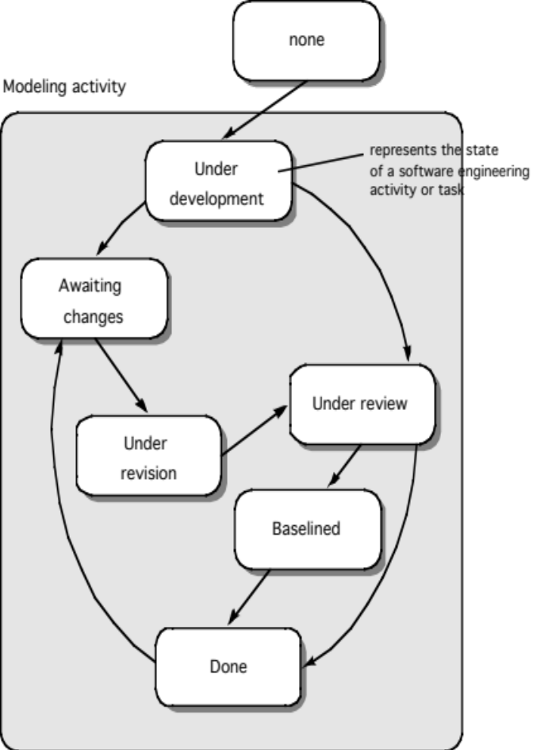
Concurrent Model
Allow a software team to represent iterative and concurrent elements of any of the process models.
Eg. modeling may be in any one of the states at any given time.
Concurrent modeling is applicable to all types of software development and provides an accurate picture of the current state of a project.
it defines a process network.

Slide 20
Concerns on Evolutionary Processes
The uncertain number of cycles affects project planning.
It does not establish the maximum speed of the evolution
Software processes should be focused on flexibility and extensibility rather than on high quality.

Slide 21
Specialized Process Models
Component based development—the process to apply when reuse is a development objective ( like a spiral model)
Formal methods— emphasize the mathematical specification of requirements ( easy to discover and eliminate ambiguity, incompleteness, and inconsistency)
Aspect Oriented software development (AOSD)—provides a process and methodological approach for defining, specifying, designing, and constructing aspects
Unified Process—a “use-case driven, architecture-centric, iterative and incremental” software process closely aligned with the Unified Modeling Language (UML) to model and develop object-oriented systems iteratively and incrementally.

Slide 22

The Unified Process (UP)
elaboration
inception

Slide 23
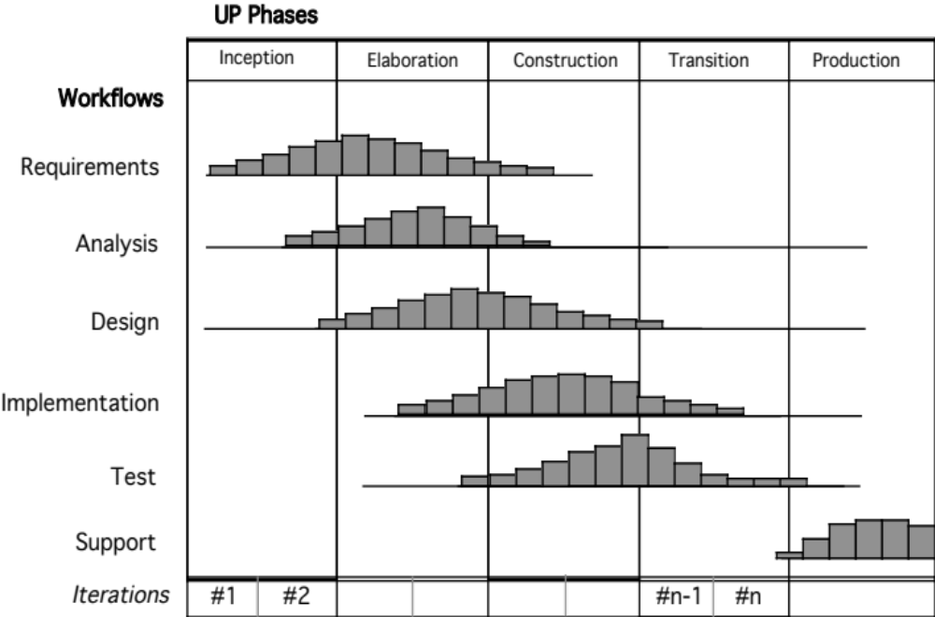
UP Phases

Slide 24
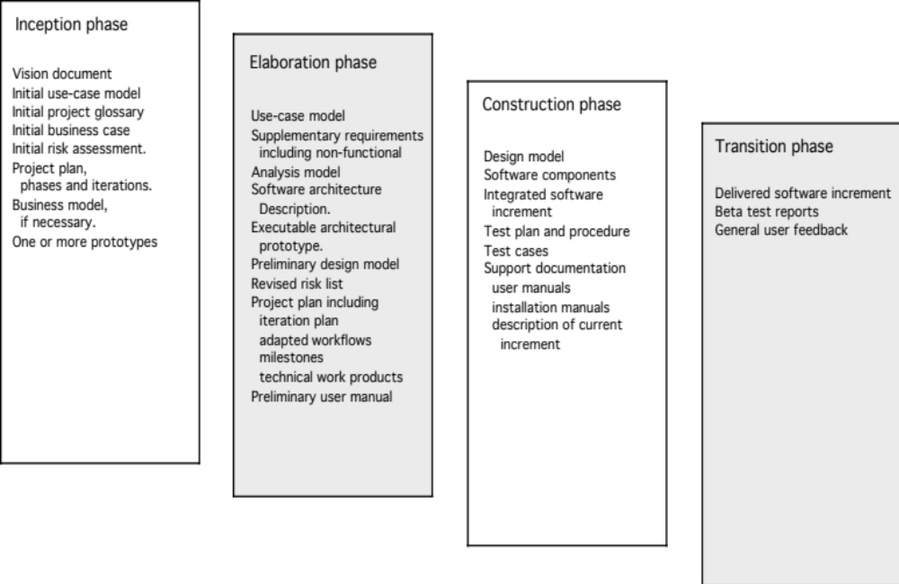
UP Work Products

Slide 25
Personal Software Process (PSP)
Planning.
  isolates requirements and develops both size and resource estimates.
  a defect estimate (the number of defects projected for the work) is made.
  All metrics are recorded on worksheets or templates.
  Development tasks are identified and a project schedule is created.
High-level design.
  External specifications for each component to be constructed are developed and a component design is created.
  Prototypes are built when uncertainty exists.
  All issues are recorded and tracked.
High-level design review.
  Formal verification methods are applied to uncover errors in the design.
  Metrics are maintained for all important tasks and work results.
Development.
  The component level design is refined and reviewed.
  Code is generated, reviewed, compiled, and tested.
  Metrics are maintained for all important tasks and work results.
Postmortem.
  Using the measures and metrics collected the effectiveness of the process is determined.
  Measures and metrics should provide guidance for modifying the process to improve its effectiveness.

Slide 26
Team Software Process (TSP)
Build self-directed teams that plan and track their work, establish goals, and own their processes and plans.
Can be pure software teams or integrated product teams (IPT) of three to about 20 engineers.
Show managers how to coach and motivate their teams and how to help them sustain peak performance.
Accelerate software process improvement by making CMM Level 5 behavior normal and expected.
  The Capability Maturity Model (CMM), a measure of the effectiveness of a software process.
Provide improvement guidance to high-maturity organizations.
Facilitate university teaching of industrial-grade team skills.

